Slide 1
Unit 1 Analysis of Algorithms
Kinjal Mistree
Department of Computer Engineering, CGPIT, UTU

Slide 2
Topics to be covered
Algorithm
Efficiency of algorithms
Performance analysis of algorithm
Elementary operation
Asymptotic Notation
Analyzing control statements
Average and worst case analysis
Solving recurrences

Slide 3
Analysing control statements

Slide 4
Types of control Structures
The algorithm include following three types of control structures.
Sequence: In the sequence structure, statements are placed one after the other and the execution takes place starting from up to down.
Branching (Selection): In branch control, there is a condition and according to a condition, a decision of either TRUE or FALSE is achieved. In the case of TRUE, one of the two branches is explored; but in the case of FALSE condition, the other alternative is taken. Generally, the ‘IF-THEN’ is used to represent branch control.
Loop (Repetition): The Loop or Repetition allows a statement(s) to be executed repeatedly based on certain loop condition e.g. WHILE, FOR loops.

Slide 5
Sequence control Structures
Sequence: In the sequence structure, statements are placed one after the other and the execution takes place starting from up to down.
Statement 1
Statement 2
.
.
Statement k
Total Time = time(Statement 1) + time(Statement 2) + ..+ time(Statement k)
If each statement is simple, then time of each statement is constant and total time = O(1).

Slide 6
Example 1: Calculate Time Complexity of calculating square.
n is an input integer
int square(int n)
{
Line 1 square = 1;
Line 2 square = n * n;
Line 3 cout << square;
Line 4 return square;
}
Line
Cost
No of Times
1
1
1
2
2
1
3
1
1
4
1
1
T_{square} = 1(1) + 1(2) + 1(1) + 1(1)
= O (1)
We can neglect constant value
Time complexity of given algorithm is 1 unit time -> O(1)

Slide 7
Branching control Structures
Branching (Selection): In branch control, there is a condition and according to a condition, a decision of either TRUE or FALSE is achieved. In the case of TRUE, one of the two branches is explored; but in the case of FALSE condition, the other alternative is taken. Generally, the ‘IF-THEN’ is used to represent branch control.
if (condition) then
Statement 1
else
Statement 2
Either of two statements are executed so,
max(time(Statement 1), time(Statement 2))

Slide 8
Example 2: Calculate Time Complexity of check the number is maximum or not.
int max(int n)
{
Line 1 max = 1000;
Line 2 if (n > max)
Line 3 max = n;
Line 4 else
Line 5 printf(“Nothing found”);
Line 6 return max;
}
n is an input integer & n = 3004
Line
Cost
No of Times
1
1
1
2
1
1
3
1
1
4
0
0
5
0
0
6
1
1
T_{max} = 1(1) + 1(1) + 1(1) + 1(1)
= O (1)
We can neglect constant value
Time complexity of given algorithm is 1 unit time -> O(1)

Slide 9
LOOP control Structures
Loop (Repetition): The Loop or Repetition allows a statement(s) to be executed repeatedly based on certain loop condition e.g. WHILE, FOR loops.
Example of For Loop:
for i = 1 to n
sequence of statements
End
Count = Number of times expression is checked for condition.
Loop will be executed n+1 times and sequence of statements will take constant time O(1), so
(n + 1) * O(1) = O(n + 1)

Slide 10
Example 3: Calculate Time Complexity of Sum of elements of List (One dimensional Array).
A is array, n is no of elements in array
SumOfList(A,n)
{
Line 1 total = 0
Line 2 for i = 0 to n-1
Line 3 total = total + A[i]
Line 4 return total
}
Line
Cost
No of Times
1
c1
1
2
c2
n + 1
3
c3
n
4
c4
1
TSumOfList = c1(1) + c2(n+1) + c3(n) + c4(1)
= (c2+c3) n + (c1+c2+c4)
We can neglect constants
= O(n)
Time complexity of given algorithm is n unit time

Slide 11
Example 4: Calculate Time Complexity.
int count(int n)
{
Line 1 sum = 0
Line 2 for i = 1 to n
Line 3 for i = 1 to m
sum++
Line 4 return 1
}
Line
Cost
No of Times
1
c1
1
2
c2
n + 1
3
c3
n(m+1)
4
c4
nm
5
c5
1
TSumOfList = c1(1) + c2(n+1) + c3(n(m+1)) + c4(nm) + c5(1)
= (c3+c4)nm + (c2+c3)n + (c1+c2+c5)
We can neglect constants
= O(nm)
Time complexity of given algorithm is nm unit time

Slide 12
Example 5: Calculate Time Complexity.
Line 1 max = x_{i}
Line 2 for i = 2 to n
Line 3 if x_{i} > max
Line 4 max = x_{i}
Line 5 print max
Line
Cost
No of Times
1
c1
1
2
c2
n
3
c3
n-1
4
c4
0
5
c5
1
TSumOfList = c1(1) + c2(n) + c3(n-1) + c4(0) + c5(1)
= (c2 + c3)n + (c1 - c3 + c5)
= O(n)
Time complexity of given algorithm is n unit time

Slide 13
Example 6: Calculate Time Complexity.
Line 1 int n;
Line 2 for(i=1, i<n, i++)
Line 3 print(“Hello”)
Line 4 for(j=n, j>0, j--)
Line 5 print(“World”)
Line
Cost
No of Times
1
c1
1
2
c2
n
3
c3
n-1
4
c4
n+1
5
c5
n
TSumOfList = c1(1) + c2(n) + c3(n-1) + c4(n+1) + c5(n)
= (c2 + c3 + c4 + c5)n + (c1 - c3 + c4)
= O(n)
Time complexity of given algorithm is n unit time

Slide 14
LOOP control Structures
While loop:
WHILE condition LOOP
sequence_of_statements ;
END LOOP;
Count = Number of times while statement is executed.

Slide 15
Example 7: Calculate Time Complexity of searching element / decrementing loop
fun(a, x, n)
{
Line 1 i = n;
Line 2 a[0] = x;
Line 3 while (a[i] != x) do
Line 4 i = i - 1;
Line 5 return i;
}
Line
Cost
No of Times
1
c1
1
2
c2
1
3
c3
n+1
4
c4
n
5
c5
1
T_{fun} = c1(1) + c2(1) + c3(n+1) + c4(n) + c5(1)
= (c3 + c4)n + (c1 + c2 + c3 + c5)
= O(n)
Time complexity of given algorithm is n unit time

Slide 16
Example 8: Calculate Time Complexity of Sorting of an array elements of List (One dimensional Array).
A is array, n is no of elements in array
SortOfList(A,n)
{
Line 1 total = 0
Line 2 for i = 0 to n-1
Line 3 for j = i+1 to n-1
Line 4 if(A[i]>A[j])
Line 5 swap(A[i],A[j])
Line 6 return A
}
Line
Cost
No of Times
1
1
1
2
2
n + 1
3
2
n(n-1)
4
1
n(n-2)
5
1
n(n-2)
6
1
1
TSumOfList = 1 + 2 (n+1) + 2n(n-1) + n(n-2) + n(n-2) + 1
= 4n² – 4n + 4
We can neglate constant 4
= O(n²)
Time complexity of given algorithm is n² unit time

Slide 17


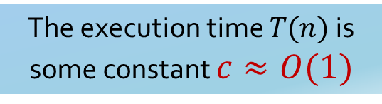





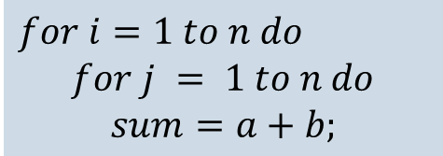


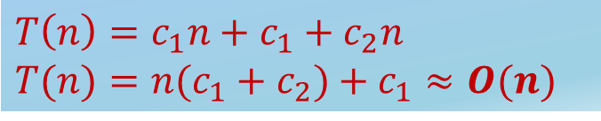

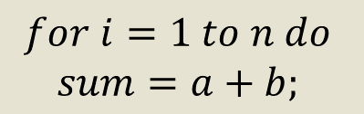

Some more for loop examples
Example 9:
$$sum=a+b$$
$$c$$
Example 11:
Statement is executed once only
$$c_{1} \left(n+1\right)$$
The execution time $T(n)$ is some constant $c≈O(1)$
$$for i=1 to n do$$
$$for j = 1 to n do$$
$$sum=a+b;$$
$$c_{2} n \left(n+1\right)$$
$$c_{3}∗n∗n$$
Example 10:
Analysis
$$∗\left(n+1\right)$$
$$for i=1 to n do$$
$$sum=a+b;$$
$$c_{1}$$
$$T(n)=c_{1}(n+1)+c_{2}n(n+1)+c_{3}n(n)$$
$$∗\left(n\right)$$
$$T(n) =c_{1}n+c_{1}+c_{2}n2+c_{2}n+c_{3}n2$$
$$c_{2}$$
Total time is denoted as,
$$T(n) = n2(c_{2}+c_{3}) + n(c_{1}+c_{2}) +c_{1}$$
$$T\left(n\right)=c_{1}n+c_{1}+c_{2}n$$
$$T(n)=n(c_{1}+c_{2})+c_{1}≈O(n)$$
$$T(n) = an2 + bn + c$$
$$T(n)=O\left(n^{2}\right)$$

Slide 18

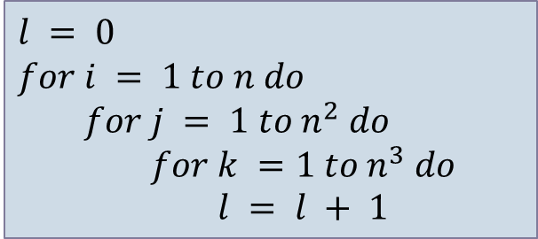

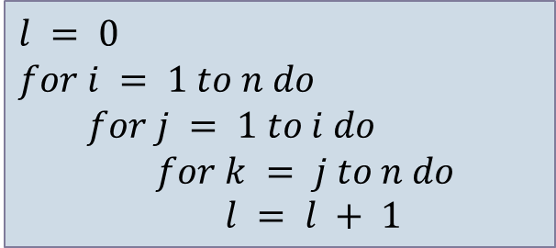


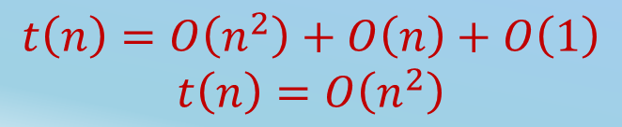


Some more for loop examples
Example 12:
Example 14:
$$l = 0$$
$$for i = 1 to n do$$
$$for j = 1 to i do$$
$$for k = j to n do$$
$$l = l + 1$$
$$for j = 1 to n do$$
$$for k = 1 to j do$$
$$sum = sum + j∗k$$
$$for l =1 to n do$$
$$sum=sum− l + 1$$
printf(“sum is now %d”,$sum$)
O$\left(n^{2}\right)$
O$\left(n\right)$
$$t\left(n\right)=O\left(n^{3}\right)$$
O$\left(1\right)$
Example 13:
$$l = 0$$
$$for i = 1 to n do$$
$$for j = 1 to n^{2} do$$
$$for k =1 to n^{3} do$$
$$l = l + 1$$
$$t\left(n\right)=O\left(n^{2}\right)+O\left(n\right)+O\left(1\right)$$
$$t\left(n\right)=O\left(n^{2}\right)$$
$$t\left(n\right)=O\left(n^{6}\right)$$

Slide 19
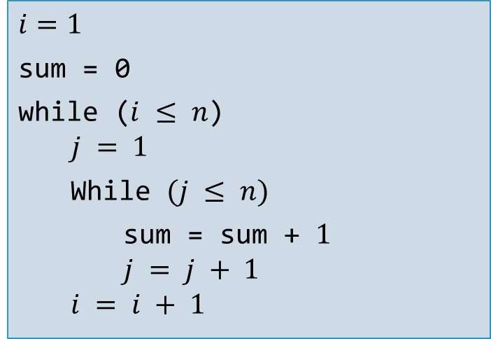
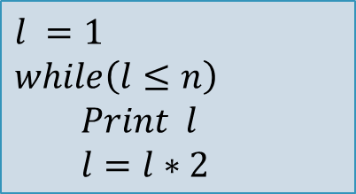
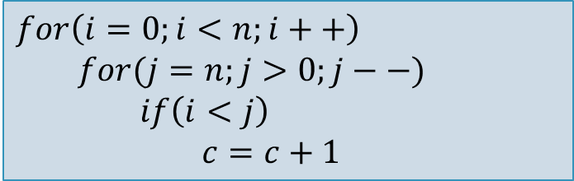
Home Work
Example 15:
Example 17:
$$l =1$$
$$while\left(l≤n\right)$$
$$Print l$$
$$l=l∗2$$
$$i=1$$
sum = 0
while ($i ≤ n$)
$$j = 1$$
While $(j ≤ n)$
sum = sum + $1$
$$j = j + 1$$
$$i = i + 1$$
Example 16:
$$for\left(i=0;i<n;i++\right)$$
$$for(j=n;j>0;j−−)$$
$$if\left(i<j\right)$$
$$c=c+1$$

Slide 20
Example 15: Calculate Time Complexity of Sorting of an array elements of List using bubble sort technique(One dimensional Array)
(Exercise)
A is array, n is no of elements in array
SortOfList(A,n)
{
Line 1 total = 0
Line 2 for i = 0 to n-1
Line 3 swapped = false
Line 4 for j = 0 to n-i-1
Line 5 if(A[j]>A[j+1])
Line 6 swap(A[j],A[j+1])
Line 7 swapped = true
Line 8 if(swapped = false)
Line 9 break
Line 10 return A
}
Time complexity of given algorithm is n for best case and n² for worst case unit time

